Slide 1


HR Analytics Dashboard

Slide 2
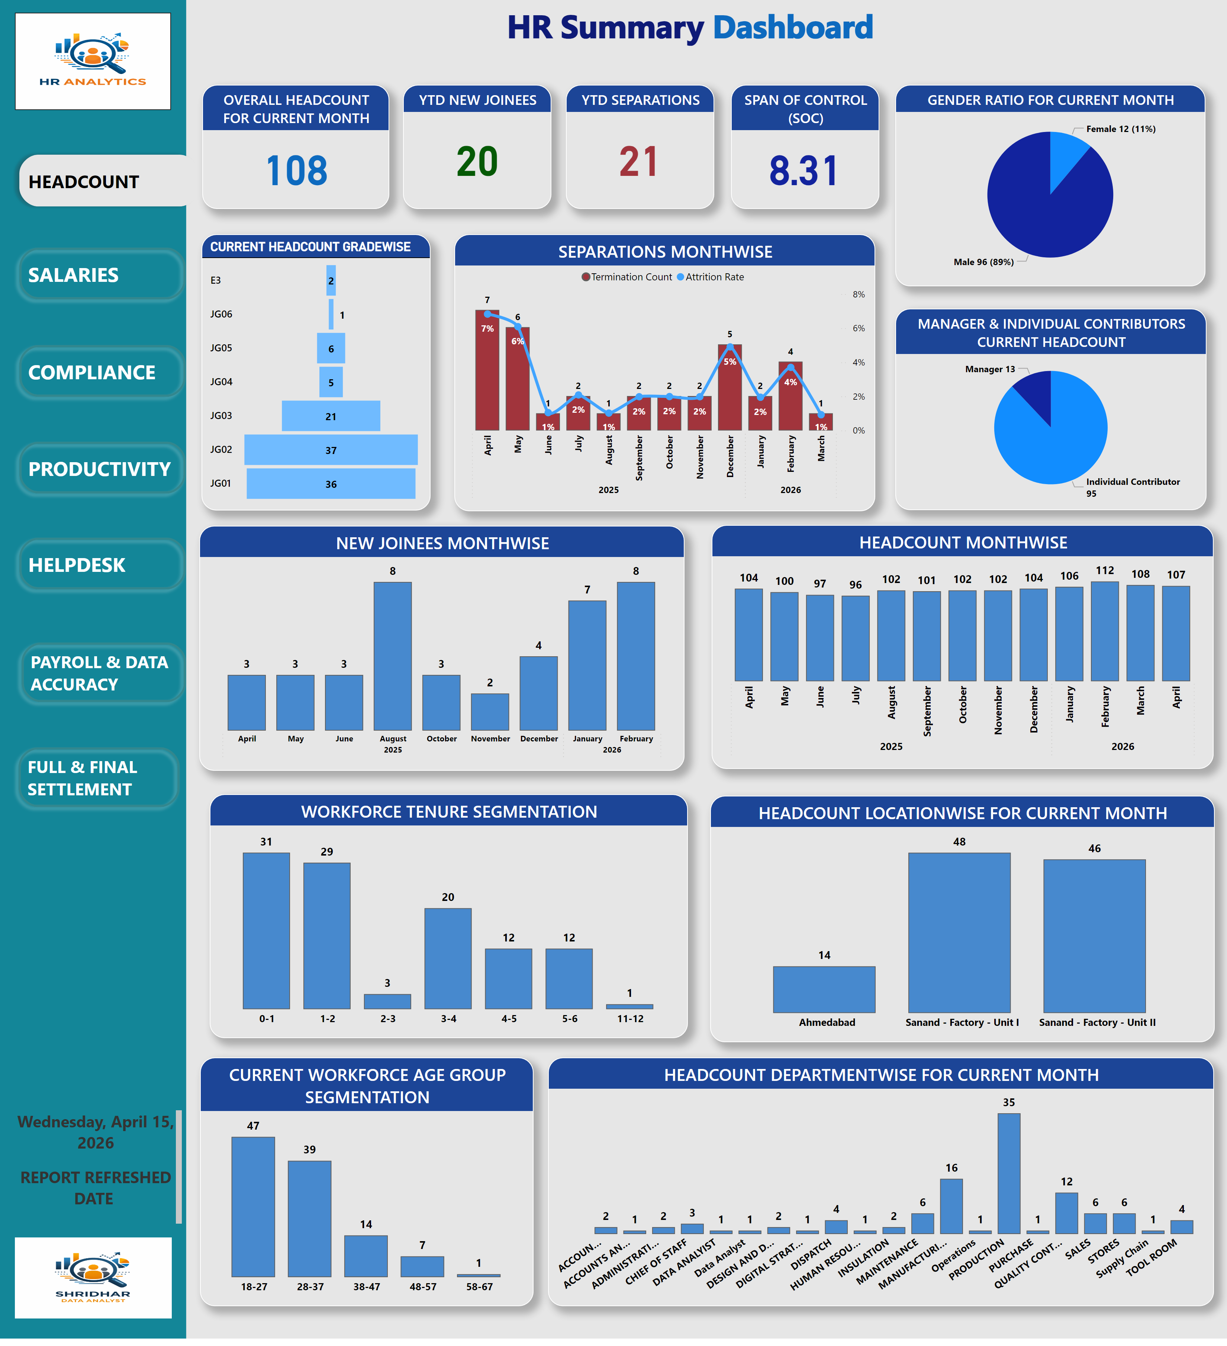
Dashboard
Notes:
shape
No alt text provided
Headcount AB
No alt text provided
actionButton
No alt text provided
actionButton
No alt text provided
actionButton
No alt text provided
actionButton
No alt text provided
actionButton
No alt text provided
actionButton
No alt text provided
actionButton
No alt text provided
Salaries IAB
No alt text provided
Compliance IAB
No alt text provided
Productivity IAB
No alt text provided
F&F IAB
No alt text provided
Qry Mgt IAB
No alt text provided
Data Audit IAB
No alt text provided
clusteredColumnChart
No alt text provided
OVERALL HEADCOUNT FOR CURRENT MONTH
No alt text provided
YTD NEW JOINEES
No alt text provided
YTD SEPARATIONS
No alt text provided
WORKFORCE TENURE SEGMENTATION
No alt text provided
CURRENT WORKFORCE AGE GROUP SEGMENTATION
No alt text provided
SPAN OF CONTROL (SOC)
No alt text provided
GENDER RATIO FOR CURRENT MONTH
No alt text provided
MANAGER & INDIVIDUAL CONTRIBUTORS CURRENT HEADCOUNT
No alt text provided
SEPARATIONS MONTHWISE
No alt text provided
NEW JOINEES MONTHWISE
No alt text provided
CURRENT HEADCOUNT GRADEWISE
No alt text provided
HEADCOUNT MONTHWISE
No alt text provided
HEADCOUNT LOCATIONWISE FOR CURRENT MONTH
No alt text provided
HEADCOUNT DEPARTMENTWISE FOR CURRENT MONTH
No alt text provided
card
No alt text provided
card
No alt text provided
card
No alt text provided
pieChart
No alt text provided
clusteredColumnChart
No alt text provided
pieChart
No alt text provided
clusteredColumnChart
No alt text provided
clusteredColumnChart
No alt text provided
clusteredColumnChart
No alt text provided
clusteredColumnChart
No alt text provided
clusteredColumnChart
No alt text provided
clusteredColumnChart
No alt text provided
card
No alt text provided
card
No alt text provided
card
No alt text provided
card
No alt text provided
columnChart
No alt text provided
columnChart
No alt text provided
clusteredColumnChart
No alt text provided
clusteredColumnChart
No alt text provided
clusteredColumnChart
No alt text provided
clusteredColumnChart
No alt text provided
textbox
No alt text provided
funnel
No alt text provided
card
No alt text provided
card
No alt text provided
pieChart
No alt text provided
pieChart
No alt text provided
clusteredColumnChart
No alt text provided
clusteredColumnChart
No alt text provided
clusteredColumnChart
No alt text provided
clusteredColumnChart
No alt text provided
card
No alt text provided
card
No alt text provided
card
No alt text provided
card
No alt text provided
pieChart
No alt text provided
pieChart
No alt text provided
clusteredColumnChart
No alt text provided
clusteredColumnChart
No alt text provided
clusteredColumnChart
No alt text provided
clusteredColumnChart
No alt text provided
pieChart
No alt text provided
card
No alt text provided
image
No alt text provided
textbox
No alt text provided
gauge
No alt text provided
clusteredColumnChart
No alt text provided
textbox
No alt text provided
pieChart
No alt text provided
textbox
No alt text provided
columnChart
No alt text provided
card
No alt text provided
card
No alt text provided
card
No alt text provided
clusteredColumnChart
No alt text provided
clusteredColumnChart
No alt text provided
card
No alt text provided
card
No alt text provided
clusteredColumnChart
No alt text provided
clusteredColumnChart
No alt text provided
image
No alt text provided
textbox
No alt text provided

Slide 3
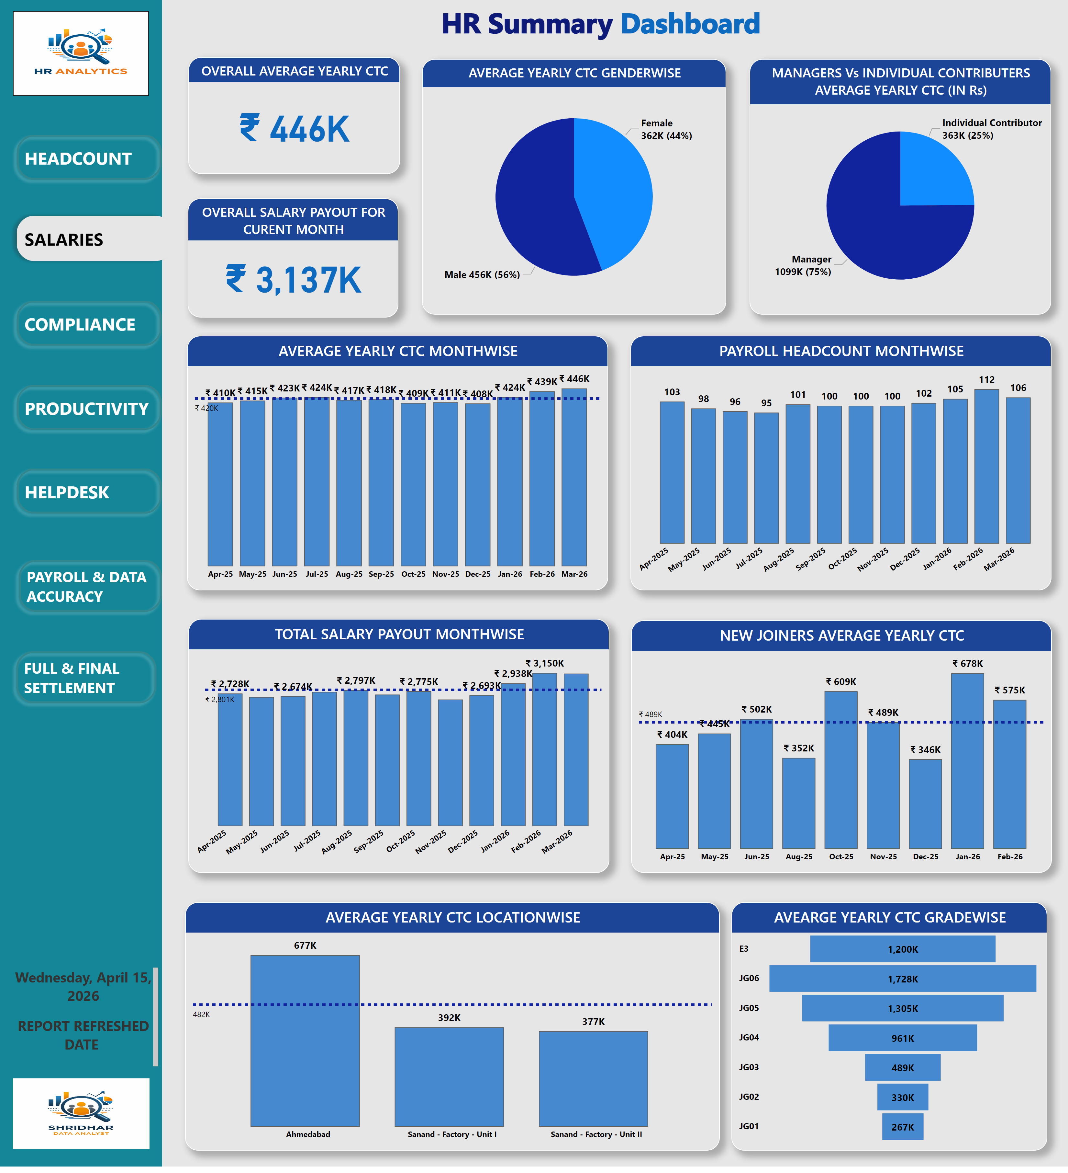
Dashboard
Notes:
shape
No alt text provided
actionButton
No alt text provided
Salaries AB
No alt text provided
actionButton
No alt text provided
actionButton
No alt text provided
actionButton
No alt text provided
actionButton
No alt text provided
actionButton
No alt text provided
Headcount IAB
No alt text provided
actionButton
No alt text provided
Compliance IAB
No alt text provided
Productivity IAB
No alt text provided
F&F IAB
No alt text provided
Qry Mgt IAB
No alt text provided
Data Audit IAB
No alt text provided
clusteredColumnChart
No alt text provided
card
No alt text provided
card
No alt text provided
card
No alt text provided
clusteredColumnChart
No alt text provided
clusteredColumnChart
No alt text provided
card
No alt text provided
pieChart
No alt text provided
pieChart
No alt text provided
lineClusteredColumnComboChart
No alt text provided
clusteredColumnChart
No alt text provided
funnel
No alt text provided
clusteredColumnChart
No alt text provided
clusteredColumnChart
No alt text provided
clusteredColumnChart
No alt text provided
card
No alt text provided
card
No alt text provided
card
No alt text provided
pieChart
No alt text provided
clusteredColumnChart
No alt text provided
pieChart
No alt text provided
clusteredColumnChart
No alt text provided
clusteredColumnChart
No alt text provided
clusteredColumnChart
No alt text provided
clusteredColumnChart
No alt text provided
clusteredColumnChart
No alt text provided
clusteredColumnChart
No alt text provided
card
No alt text provided
card
No alt text provided
card
No alt text provided
card
No alt text provided
columnChart
No alt text provided
columnChart
No alt text provided
clusteredColumnChart
No alt text provided
clusteredColumnChart
No alt text provided
clusteredColumnChart
No alt text provided
clusteredColumnChart
No alt text provided
textbox
No alt text provided
AVEARGE YEARLY CTC GRADEWISE
No alt text provided
OVERALL AVERAGE YEARLY CTC
No alt text provided
OVERALL SALARY PAYOUT FOR CURENT MONTH
No alt text provided
AVERAGE YEARLY CTC GENDERWISE
No alt text provided
MANAGERS Vs INDIVIDUAL CONTRIBUTERS AVERAGE YEARLY CTC (IN Rs)
No alt text provided
AVERAGE YEARLY CTC MONTHWISE
No alt text provided
PAYROLL HEADCOUNT MONTHWISE
No alt text provided
TOTAL SALARY PAYOUT MONTHWISE
No alt text provided
AVERAGE YEARLY CTC LOCATIONWISE
No alt text provided
card
No alt text provided
card
No alt text provided
card
No alt text provided
card
No alt text provided
pieChart
No alt text provided
pieChart
No alt text provided
clusteredColumnChart
No alt text provided
clusteredColumnChart
No alt text provided
clusteredColumnChart
No alt text provided
clusteredColumnChart
No alt text provided
pieChart
No alt text provided
card
No alt text provided
image
No alt text provided
textbox
No alt text provided
gauge
No alt text provided
clusteredColumnChart
No alt text provided
textbox
No alt text provided
pieChart
No alt text provided
textbox
No alt text provided
columnChart
No alt text provided
card
No alt text provided
card
No alt text provided
card
No alt text provided
clusteredColumnChart
No alt text provided
NEW JOINERS AVERAGE YEARLY CTC
No alt text provided
card
No alt text provided
card
No alt text provided
clusteredColumnChart
No alt text provided
clusteredColumnChart
No alt text provided
image
No alt text provided
textbox
No alt text provided

Slide 4
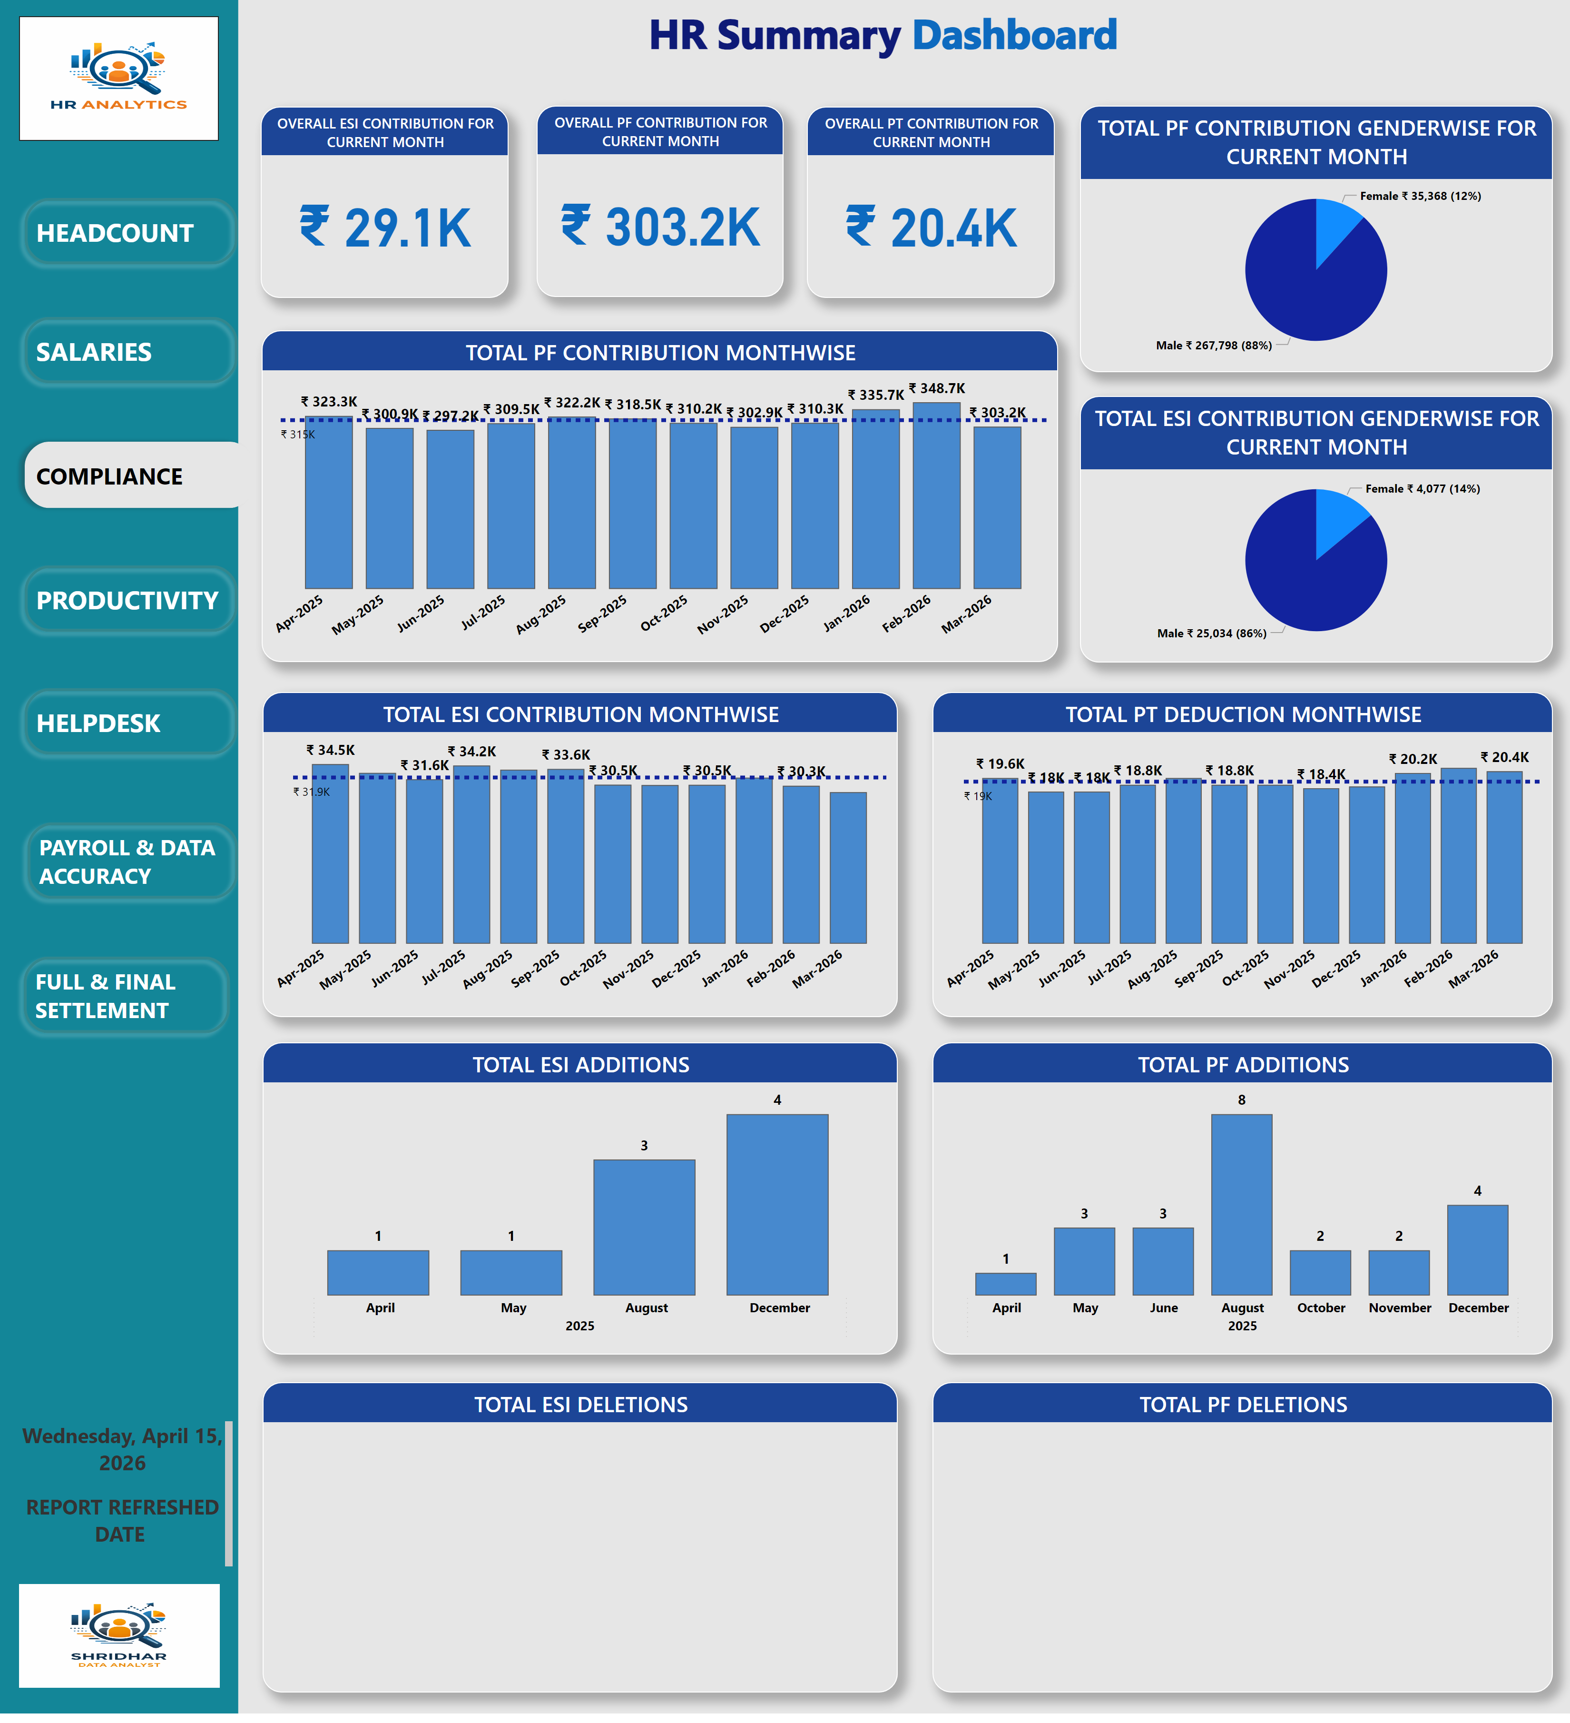
Dashboard
Notes:
shape
No alt text provided
actionButton
No alt text provided
actionButton
No alt text provided
Compliance AB
No alt text provided
actionButton
No alt text provided
actionButton
No alt text provided
actionButton
No alt text provided
actionButton
No alt text provided
Headcount IAB
No alt text provided
Salaries IAB
No alt text provided
actionButton
No alt text provided
Productivity IAB
No alt text provided
F&F IAB
No alt text provided
Qry Mgt IAB
No alt text provided
Data Audit IAB
No alt text provided
clusteredColumnChart
No alt text provided
card
No alt text provided
card
No alt text provided
card
No alt text provided
clusteredColumnChart
No alt text provided
clusteredColumnChart
No alt text provided
card
No alt text provided
pieChart
No alt text provided
pieChart
No alt text provided
lineClusteredColumnComboChart
No alt text provided
clusteredColumnChart
No alt text provided
funnel
No alt text provided
clusteredColumnChart
No alt text provided
clusteredColumnChart
No alt text provided
clusteredColumnChart
No alt text provided
OVERALL ESI CONTRIBUTION FOR CURRENT MONTH
No alt text provided
OVERALL PF CONTRIBUTION FOR CURRENT MONTH
No alt text provided
OVERALL PT CONTRIBUTION FOR CURRENT MONTH
No alt text provided
TOTAL PF CONTRIBUTION GENDERWISE FOR CURRENT MONTH
No alt text provided
TOTAL PF CONTRIBUTION MONTHWISE
No alt text provided
TOTAL ESI CONTRIBUTION GENDERWISE FOR CURRENT MONTH
No alt text provided
TOTAL ESI CONTRIBUTION MONTHWISE
No alt text provided
TOTAL PT DEDUCTION MONTHWISE
No alt text provided
TOTAL PF ADDITIONS
No alt text provided
TOTAL ESI ADDITIONS
No alt text provided
TOTAL ESI DELETIONS
No alt text provided
TOTAL PF DELETIONS
No alt text provided
card
No alt text provided
card
No alt text provided
card
No alt text provided
card
No alt text provided
columnChart
No alt text provided
columnChart
No alt text provided
clusteredColumnChart
No alt text provided
clusteredColumnChart
No alt text provided
clusteredColumnChart
No alt text provided
clusteredColumnChart
No alt text provided
textbox
No alt text provided
funnel
No alt text provided
card
No alt text provided
card
No alt text provided
pieChart
No alt text provided
pieChart
No alt text provided
clusteredColumnChart
No alt text provided
clusteredColumnChart
No alt text provided
clusteredColumnChart
No alt text provided
clusteredColumnChart
No alt text provided
card
No alt text provided
card
No alt text provided
card
No alt text provided
card
No alt text provided
pieChart
No alt text provided
pieChart
No alt text provided
clusteredColumnChart
No alt text provided
clusteredColumnChart
No alt text provided
clusteredColumnChart
No alt text provided
clusteredColumnChart
No alt text provided
pieChart
No alt text provided
card
No alt text provided
image
No alt text provided
textbox
No alt text provided
gauge
No alt text provided
clusteredColumnChart
No alt text provided
textbox
No alt text provided
pieChart
No alt text provided
textbox
No alt text provided
columnChart
No alt text provided
card
No alt text provided
card
No alt text provided
card
No alt text provided
clusteredColumnChart
No alt text provided
clusteredColumnChart
No alt text provided
card
No alt text provided
card
No alt text provided
clusteredColumnChart
No alt text provided
clusteredColumnChart
No alt text provided
image
No alt text provided
textbox
No alt text provided

Slide 5
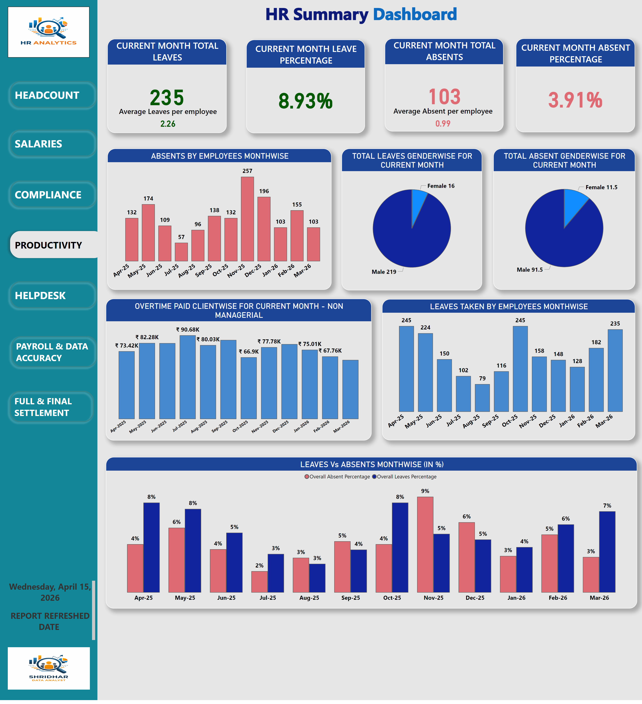
Dashboard
Notes:
shape
No alt text provided
actionButton
No alt text provided
actionButton
No alt text provided
actionButton
No alt text provided
Productivity AB
No alt text provided
actionButton
No alt text provided
actionButton
No alt text provided
actionButton
No alt text provided
Headcount IAB
No alt text provided
Salaries IAB
No alt text provided
Compliance IAB
No alt text provided
actionButton
No alt text provided
F&F IAB
No alt text provided
Qry Mgt IAB
No alt text provided
Data Audit IAB
No alt text provided
clusteredColumnChart
No alt text provided
card
No alt text provided
card
No alt text provided
card
No alt text provided
clusteredColumnChart
No alt text provided
clusteredColumnChart
No alt text provided
card
No alt text provided
pieChart
No alt text provided
pieChart
No alt text provided
lineClusteredColumnComboChart
No alt text provided
clusteredColumnChart
No alt text provided
funnel
No alt text provided
clusteredColumnChart
No alt text provided
clusteredColumnChart
No alt text provided
clusteredColumnChart
No alt text provided
card
No alt text provided
card
No alt text provided
card
No alt text provided
pieChart
No alt text provided
clusteredColumnChart
No alt text provided
pieChart
No alt text provided
clusteredColumnChart
No alt text provided
clusteredColumnChart
No alt text provided
clusteredColumnChart
No alt text provided
clusteredColumnChart
No alt text provided
clusteredColumnChart
No alt text provided
clusteredColumnChart
No alt text provided
card
No alt text provided
card
No alt text provided
card
No alt text provided
card
No alt text provided
columnChart
No alt text provided
columnChart
No alt text provided
clusteredColumnChart
No alt text provided
clusteredColumnChart
No alt text provided
clusteredColumnChart
No alt text provided
clusteredColumnChart
No alt text provided
textbox
No alt text provided
funnel
No alt text provided
card
No alt text provided
card
No alt text provided
pieChart
No alt text provided
pieChart
No alt text provided
clusteredColumnChart
No alt text provided
clusteredColumnChart
No alt text provided
clusteredColumnChart
No alt text provided
clusteredColumnChart
No alt text provided
CURRENT MONTH TOTAL ABSENTS
No alt text provided
CURRENT MONTH LEAVE PERCENTAGE
No alt text provided
CURRENT MONTH TOTAL LEAVES
No alt text provided
CURRENT MONTH ABSENT PERCENTAGE
No alt text provided
TOTAL ABSENT GENDERWISE FOR CURRENT MONTH
No alt text provided
TOTAL LEAVES GENDERWISE FOR CURRENT MONTH
No alt text provided
ABSENTS BY EMPLOYEES MONTHWISE
No alt text provided
LEAVES Vs ABSENTS MONTHWISE (IN %)
No alt text provided
LEAVES TAKEN BY EMPLOYEES MONTHWISE
No alt text provided
OVERTIME PAID CLIENTWISE FOR CURRENT MONTH - NON MANAGERIAL
No alt text provided
pieChart
No alt text provided
card
No alt text provided
image
No alt text provided
textbox
No alt text provided
gauge
No alt text provided
clusteredColumnChart
No alt text provided
textbox
No alt text provided
pieChart
No alt text provided
textbox
No alt text provided
columnChart
No alt text provided
card
No alt text provided
card
No alt text provided
card
No alt text provided
clusteredColumnChart
No alt text provided
clusteredColumnChart
No alt text provided
Average Leaves per employee
No alt text provided
Average Absent per employee
No alt text provided
clusteredColumnChart
No alt text provided
clusteredColumnChart
No alt text provided
image
No alt text provided
textbox
No alt text provided

Slide 6
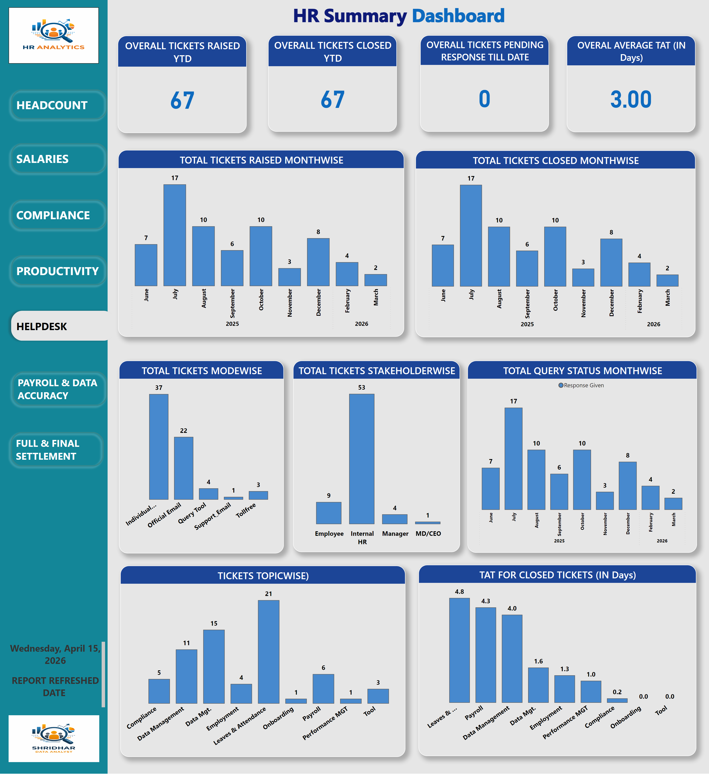
Dashboard
Notes:
shape
No alt text provided
actionButton
No alt text provided
actionButton
No alt text provided
actionButton
No alt text provided
actionButton
No alt text provided
Qry Mgt AB
No alt text provided
actionButton
No alt text provided
actionButton
No alt text provided
Headcount IAB
No alt text provided
Salaries IAB
No alt text provided
Compliance IAB
No alt text provided
Productivity IAB
No alt text provided
F&F IAB
No alt text provided
actionButton
No alt text provided
Data Audit IAB
No alt text provided
clusteredColumnChart
No alt text provided
card
No alt text provided
card
No alt text provided
card
No alt text provided
clusteredColumnChart
No alt text provided
clusteredColumnChart
No alt text provided
card
No alt text provided
pieChart
No alt text provided
pieChart
No alt text provided
lineClusteredColumnComboChart
No alt text provided
clusteredColumnChart
No alt text provided
funnel
No alt text provided
clusteredColumnChart
No alt text provided
clusteredColumnChart
No alt text provided
clusteredColumnChart
No alt text provided
card
No alt text provided
card
No alt text provided
card
No alt text provided
pieChart
No alt text provided
clusteredColumnChart
No alt text provided
pieChart
No alt text provided
clusteredColumnChart
No alt text provided
clusteredColumnChart
No alt text provided
clusteredColumnChart
No alt text provided
clusteredColumnChart
No alt text provided
clusteredColumnChart
No alt text provided
clusteredColumnChart
No alt text provided
OVERALL TICKETS RAISED YTD
No alt text provided
OVERALL TICKETS CLOSED YTD
No alt text provided
OVERAL AVERAGE TAT (IN Days)
No alt text provided
OVERALL TICKETS PENDING RESPONSE TILL DATE
No alt text provided
TOTAL TICKETS CLOSED MONTHWISE
No alt text provided
TOTAL TICKETS RAISED MONTHWISE
No alt text provided
TOTAL TICKETS MODEWISE
No alt text provided
TOTAL TICKETS STAKEHOLDERWISE
No alt text provided
TOTAL QUERY STATUS MONTHWISE
No alt text provided
TAT FOR CLOSED TICKETS (IN Days)
No alt text provided
textbox
No alt text provided
funnel
No alt text provided
card
No alt text provided
card
No alt text provided
pieChart
No alt text provided
pieChart
No alt text provided
clusteredColumnChart
No alt text provided
clusteredColumnChart
No alt text provided
clusteredColumnChart
No alt text provided
clusteredColumnChart
No alt text provided
card
No alt text provided
card
No alt text provided
card
No alt text provided
card
No alt text provided
pieChart
No alt text provided
pieChart
No alt text provided
clusteredColumnChart
No alt text provided
clusteredColumnChart
No alt text provided
clusteredColumnChart
No alt text provided
clusteredColumnChart
No alt text provided
pieChart
No alt text provided
card
No alt text provided
image
No alt text provided
textbox
No alt text provided
gauge
No alt text provided
clusteredColumnChart
No alt text provided
textbox
No alt text provided
pieChart
No alt text provided
textbox
No alt text provided
columnChart
No alt text provided
card
No alt text provided
card
No alt text provided
card
No alt text provided
TICKETS TOPICWISE)
No alt text provided
clusteredColumnChart
No alt text provided
card
No alt text provided
card
No alt text provided
clusteredColumnChart
No alt text provided
clusteredColumnChart
No alt text provided
image
No alt text provided
textbox
No alt text provided

Slide 7
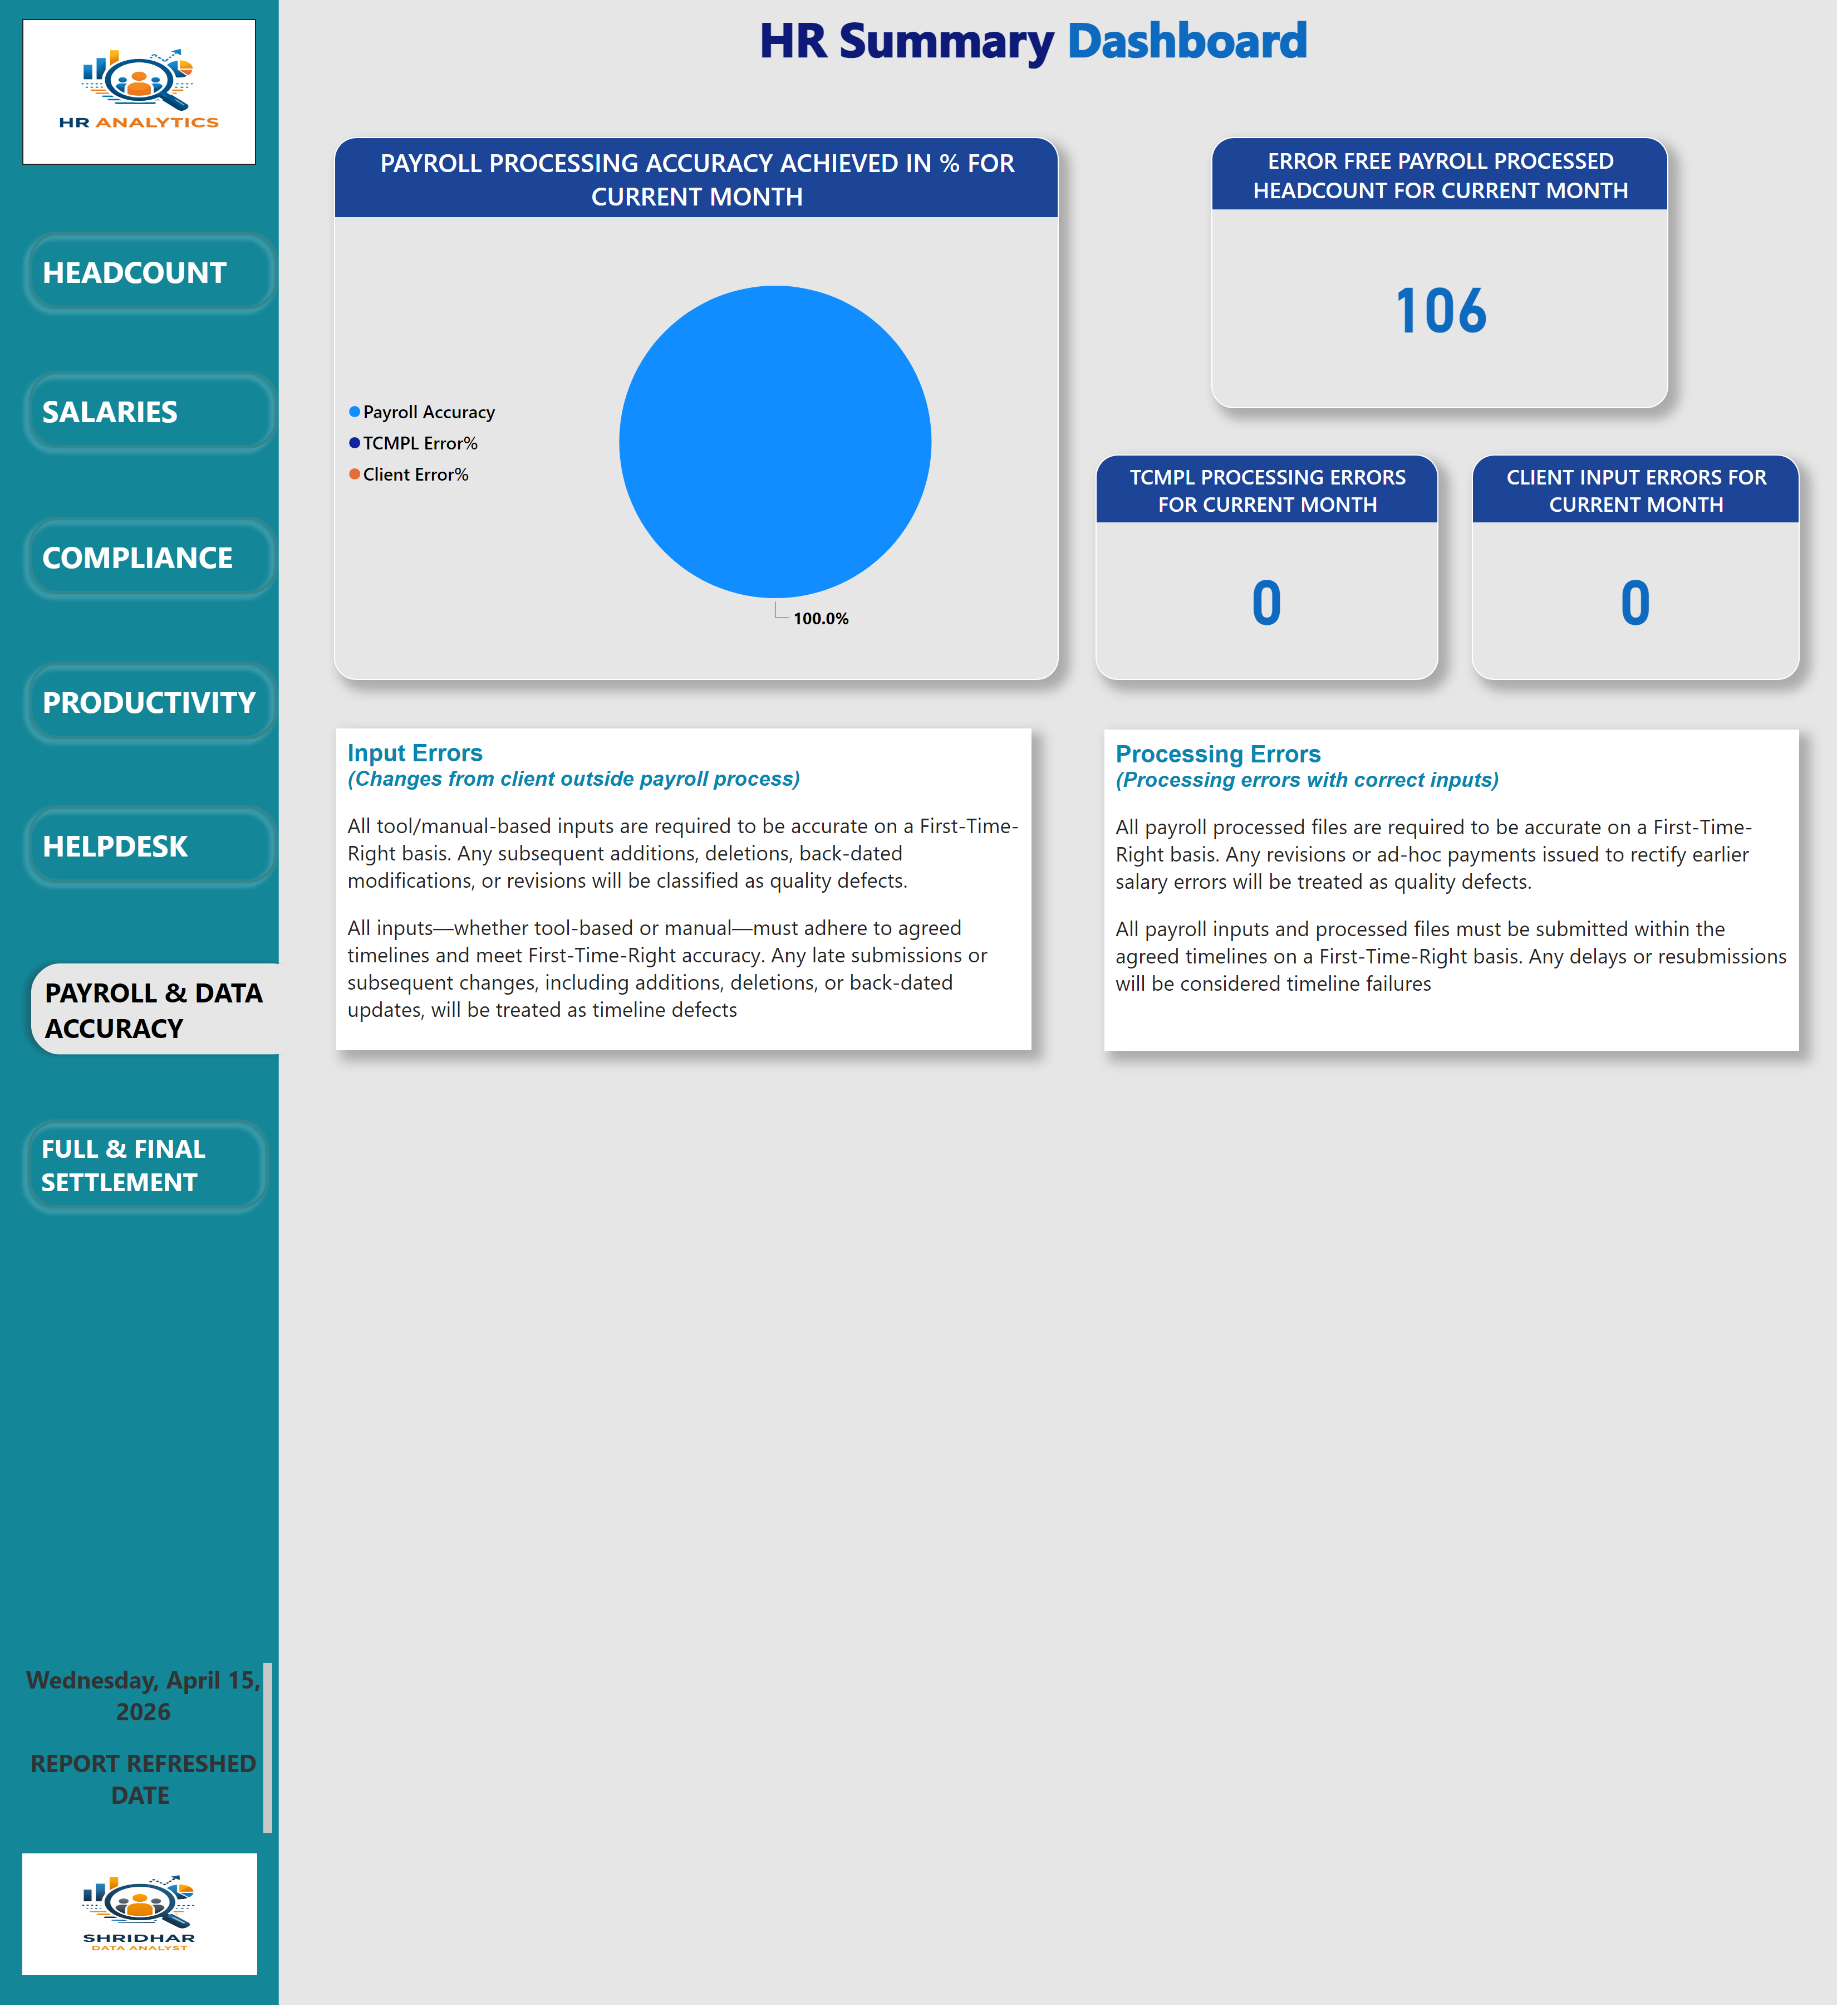
Dashboard
Notes:
shape
No alt text provided
actionButton
No alt text provided
actionButton
No alt text provided
actionButton
No alt text provided
actionButton
No alt text provided
actionButton
No alt text provided
Data Audit AB
No alt text provided
actionButton
No alt text provided
Headcount IAB
No alt text provided
Salaries IAB
No alt text provided
Compliance IAB
No alt text provided
Productivity IAB
No alt text provided
F&F IAB
No alt text provided
Qry Mgt IAB
No alt text provided
actionButton
No alt text provided
clusteredColumnChart
No alt text provided
card
No alt text provided
card
No alt text provided
card
No alt text provided
clusteredColumnChart
No alt text provided
clusteredColumnChart
No alt text provided
card
No alt text provided
pieChart
No alt text provided
pieChart
No alt text provided
lineClusteredColumnComboChart
No alt text provided
clusteredColumnChart
No alt text provided
funnel
No alt text provided
clusteredColumnChart
No alt text provided
clusteredColumnChart
No alt text provided
clusteredColumnChart
No alt text provided
card
No alt text provided
card
No alt text provided
card
No alt text provided
pieChart
No alt text provided
clusteredColumnChart
No alt text provided
pieChart
No alt text provided
clusteredColumnChart
No alt text provided
clusteredColumnChart
No alt text provided
clusteredColumnChart
No alt text provided
clusteredColumnChart
No alt text provided
clusteredColumnChart
No alt text provided
clusteredColumnChart
No alt text provided
card
No alt text provided
card
No alt text provided
card
No alt text provided
card
No alt text provided
columnChart
No alt text provided
columnChart
No alt text provided
clusteredColumnChart
No alt text provided
clusteredColumnChart
No alt text provided
clusteredColumnChart
No alt text provided
clusteredColumnChart
No alt text provided
textbox
No alt text provided
funnel
No alt text provided
card
No alt text provided
card
No alt text provided
pieChart
No alt text provided
pieChart
No alt text provided
clusteredColumnChart
No alt text provided
clusteredColumnChart
No alt text provided
clusteredColumnChart
No alt text provided
clusteredColumnChart
No alt text provided
card
No alt text provided
card
No alt text provided
card
No alt text provided
card
No alt text provided
pieChart
No alt text provided
pieChart
No alt text provided
clusteredColumnChart
No alt text provided
clusteredColumnChart
No alt text provided
clusteredColumnChart
No alt text provided
clusteredColumnChart
No alt text provided
PAYROLL PROCESSING ACCURACY ACHIEVED IN % FOR CURRENT MONTH
No alt text provided
card
No alt text provided
image
No alt text provided
textbox
No alt text provided
gauge
No alt text provided
clusteredColumnChart
No alt text provided
textbox
No alt text provided
pieChart
No alt text provided
textbox
No alt text provided
columnChart
No alt text provided
ERROR FREE PAYROLL PROCESSED HEADCOUNT FOR CURRENT MONTH
No alt text provided
TCMPL PROCESSING ERRORS FOR CURRENT MONTH
No alt text provided
CLIENT INPUT ERRORS FOR CURRENT MONTH
No alt text provided
clusteredColumnChart
No alt text provided
clusteredColumnChart
No alt text provided
card
No alt text provided
card
No alt text provided
clusteredColumnChart
No alt text provided
clusteredColumnChart
No alt text provided
image
No alt text provided
textbox
No alt text provided

Slide 8
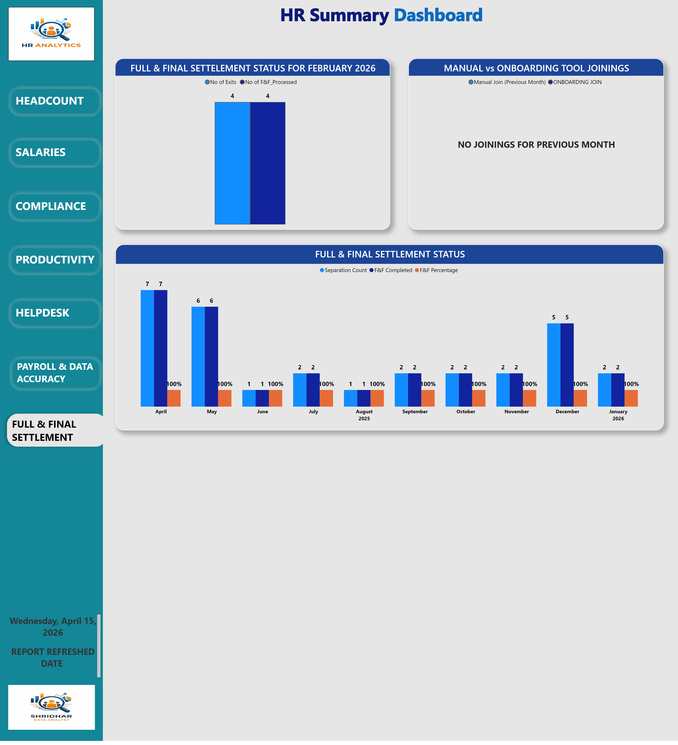
Dashboard
Notes:
shape
No alt text provided
actionButton
No alt text provided
actionButton
No alt text provided
actionButton
No alt text provided
actionButton
No alt text provided
actionButton
No alt text provided
actionButton
No alt text provided
F&F AB
No alt text provided
Headcount IAB
No alt text provided
Salaries IAB
No alt text provided
Compliance IAB
No alt text provided
Productivity IAB
No alt text provided
actionButton
No alt text provided
Qry Mgt IAB
No alt text provided
Data Audit IAB
No alt text provided
FULL & FINAL SETTLEMENT STATUS
No alt text provided
card
No alt text provided
card
No alt text provided
card
No alt text provided
clusteredColumnChart
No alt text provided
clusteredColumnChart
No alt text provided
card
No alt text provided
pieChart
No alt text provided
pieChart
No alt text provided
lineClusteredColumnComboChart
No alt text provided
clusteredColumnChart
No alt text provided
funnel
No alt text provided
clusteredColumnChart
No alt text provided
clusteredColumnChart
No alt text provided
clusteredColumnChart
No alt text provided
card
No alt text provided
card
No alt text provided
card
No alt text provided
pieChart
No alt text provided
clusteredColumnChart
No alt text provided
pieChart
No alt text provided
clusteredColumnChart
No alt text provided
clusteredColumnChart
No alt text provided
clusteredColumnChart
No alt text provided
clusteredColumnChart
No alt text provided
clusteredColumnChart
No alt text provided
clusteredColumnChart
No alt text provided
card
No alt text provided
card
No alt text provided
card
No alt text provided
card
No alt text provided
columnChart
No alt text provided
columnChart
No alt text provided
clusteredColumnChart
No alt text provided
clusteredColumnChart
No alt text provided
clusteredColumnChart
No alt text provided
clusteredColumnChart
No alt text provided
textbox
No alt text provided
funnel
No alt text provided
card
No alt text provided
card
No alt text provided
pieChart
No alt text provided
pieChart
No alt text provided
clusteredColumnChart
No alt text provided
clusteredColumnChart
No alt text provided
clusteredColumnChart
No alt text provided
clusteredColumnChart
No alt text provided
card
No alt text provided
card
No alt text provided
card
No alt text provided
card
No alt text provided
pieChart
No alt text provided
pieChart
No alt text provided
clusteredColumnChart
No alt text provided
clusteredColumnChart
No alt text provided
clusteredColumnChart
No alt text provided
clusteredColumnChart
No alt text provided
pieChart
No alt text provided
card
No alt text provided
image
No alt text provided
textbox
No alt text provided
gauge
No alt text provided
clusteredColumnChart
No alt text provided
textbox
No alt text provided
pieChart
No alt text provided
textbox
No alt text provided
columnChart
No alt text provided
card
No alt text provided
card
No alt text provided
card
No alt text provided
clusteredColumnChart
No alt text provided
clusteredColumnChart
No alt text provided
card
No alt text provided
card
No alt text provided
FULL & FINAL SETTELEMENT STATUS FOR FEBRUARY 2026
No alt text provided
MANUAL vs ONBOARDING TOOL JOININGS
No alt text provided
image
No alt text provided
textbox
No alt text provided

